Slide 1
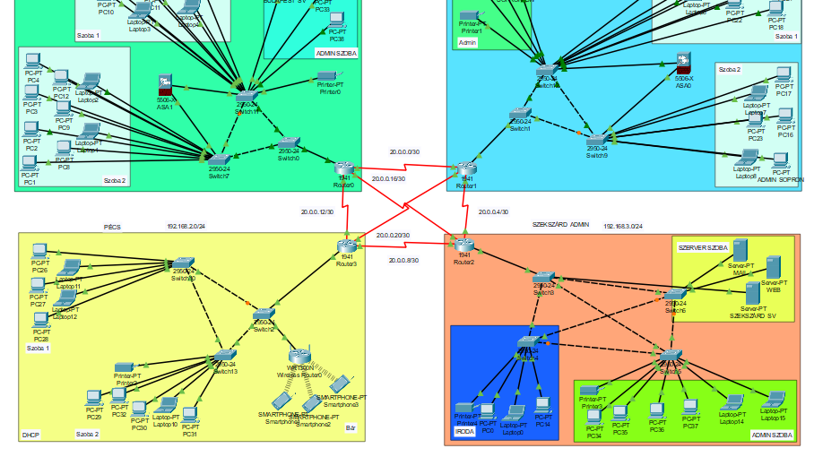
Stake Casino
Haramia Balázs, Farkas Kristóf, Müller János

Slide 2

Stake Network Presentation
Stake Casino Network
4 cities
Central managed
Budapest, Sopron, Pécs, Szekszárd
Notes:
The Stake Casino Network is currently distributed across four locations. We have casinos in Budapest, Sopron, Pécs, and Szekszárd. it's centrally managed, which allows us to maintain consistent security protocols and monitor all traffic from one primary location without needing local IT teams at every site.

Slide 3

The Stake team
Haramia Balázs (PM)
Farkas Kristóf
Müller János
Notes:
Now, let me introduce the team behind the project.
First, me, Balázs Haramia, i am the project manager. My main focus was coordinating our workflow, giving tasks, and ensuring everything was completed on time and working. Besides management, i was also heavily involved in the network configuration and supported the team wherever it was needed.
Next is Kristóf Farkas, he was responsible for designing the entire network topology from scratch. He also did the configuration of the devices and helped in anything he could throughout the process.
Finally, János Müller handled the testing and documentation. He ensured that everything functioned correctly and was responsible for putting together our technical reports and this presentation. Like the rest of us, he also helped with the configuration and troubleshooting whenever he could.

Slide 4

Overview
4 city: Budapest, Sopron, Pécs, Szekszárd
Protocols
Redundancy
Notes:
Each city operates as its own subnet, but they are all connected through a redundant routing system. We use second layer and third layer redundancy, which means that if a cable fails, the network stays online. We use protocols like RIP or GREVPN in our network. This setup guarantees that the casino operations remain uninterrupted even during a link failure.

Slide 5
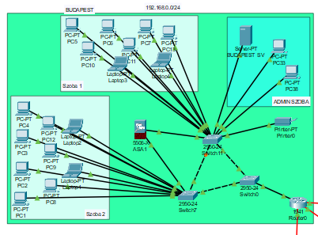
Budapest
Rooms: 2 + Admin
20 PC, 1 server, 1 printer
Firewall
Router: Connected to the Routers of the other 3 cities.
Notes:
The first city is Budapest, it has 2 rooms and an admin room, it has 20 PCs, 1 server and 1 printer. We got a firewall here, and the router is connected to the other 3 routers. We use second layer redundancy here, and in all of the cities.

Slide 6
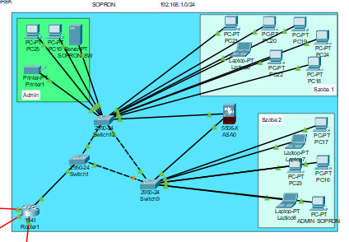
Sopron
Rooms: 2 + Admin
16 PC, 1 server, 1 printer
Firewall
Router: Connected to the Routers of the other 3 cities
Notes:
The next city is Sopron, it also has 2 rooms and an admin room, it has 16 PCs, 1 server and 1 printer. We also got a firewall here, and we have ACL for the Admin PC.

Slide 7
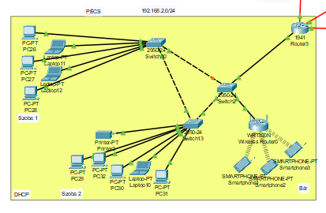
Pécs
Rooms: 2 + Bar
VLANs: Room 1, Room 2, Bar
DHCP
Wireless Router for the bar
Notes:
The next city is Pécs, it has 2 rooms and a bar, we have VLANs in here. VLANs are room 1, room 2 and the bar. We use DHCP here for the IP addresses. In the Bar, we use Wifi connection.

Slide 8
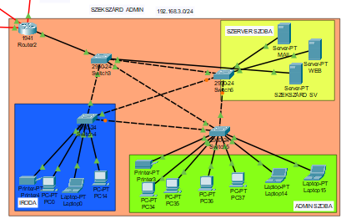
Szekszárd
Facilities: Office, Server room, Admin
12 PC, 2 printer, 3 server
Admin city
Notes:
The last and most important city is Szekszárd, its the admin city. It has an office, an admin room and a server room. We have servers here like mail and web. This city got 12 PCs, 2 printers and 3 servers. This is where we control the other cities and everything.

Slide 9
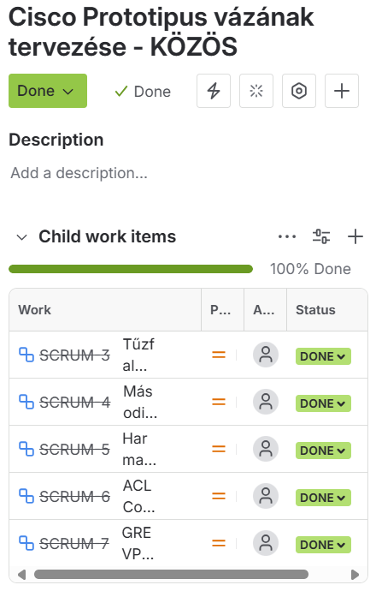
Jira documentation
Testing
Documenting
Logging working hours
Notes:
We used Jira for our project, its a very important tool, as when we had any tasks to do we used this, so we knew when we are done with it and if we got any other tasks to do. We could also see here how much time someone spent on the tasks which is very good.

Slide 10

_Git_
Version control system
Transparent development
Notes:
We also used Git for our project. It is where we upload all of our files, so we can get them anytime, like if something happens, we can still get it from the Git, as we have everything saved there.

Slide 11
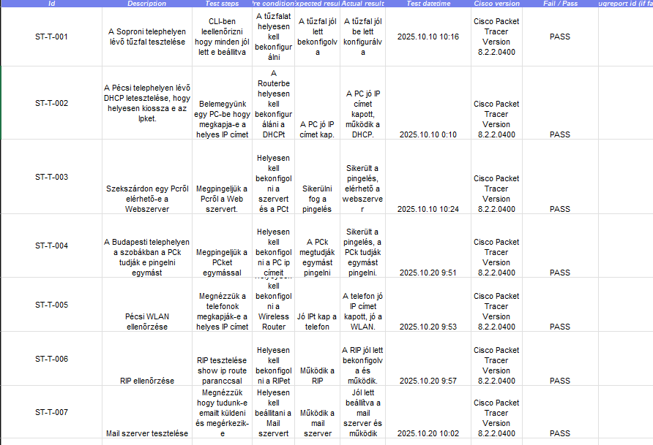

Testing
Network testing ensures that the system operates stably, quickly, and securely during everyday use.
Notes:
We tested a lot in our network to find bugs, its a very important thing as we found some bugs thanks to this, and fixed them. We used a table for the testing as you can see, it was very easy to see everything.

Slide 12
Diagram
Notes:
This diagram shows how much time we spent on the project.

Slide 13
Summary
Each city is on its own subnet
01
Redundant and secure network architecture
02
Unified DNS and logical IP structure
03
Stable connection between the casinos
04

Slide 14
Thank you for listening!
☺

